Slide 1
From a Web App to a Progressive Web App

Slide 2

Florent Morselli aka Spomky
Web developer, self-taught
Actively maintains libraries OTP, JWT, CBOR...
OAuth2.x, OIDC and Webauthn enthusiast

Slide 3
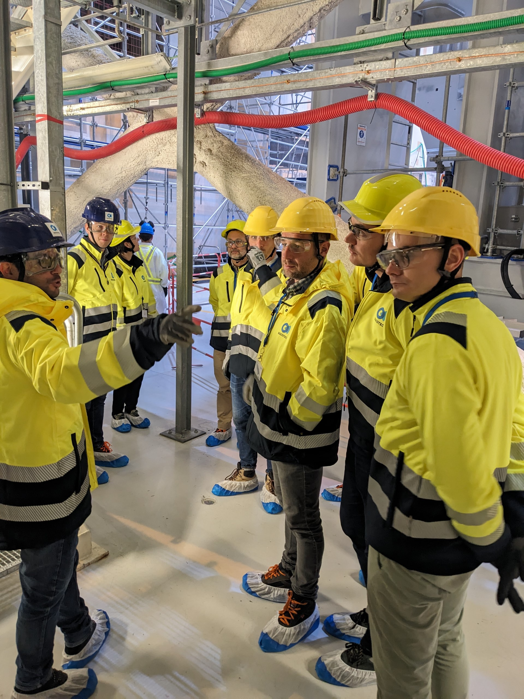
I’m not only a web developer, but also a civil engineer

Slide 4
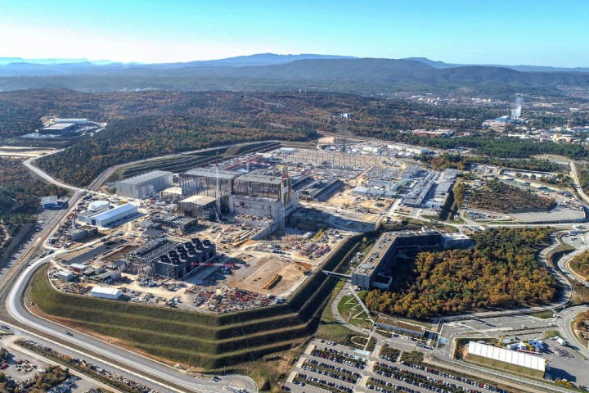
Working for the
ITER Organization since 2014
We often carry out inspections in very unique places

Slide 5
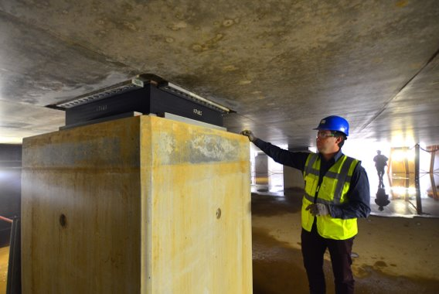
In 2023, we were asked to inspect Anti-Seismic Bearings of the TKC Buildings.
Expected activity duration: 3 weeks
Team of 3 workers

Slide 6
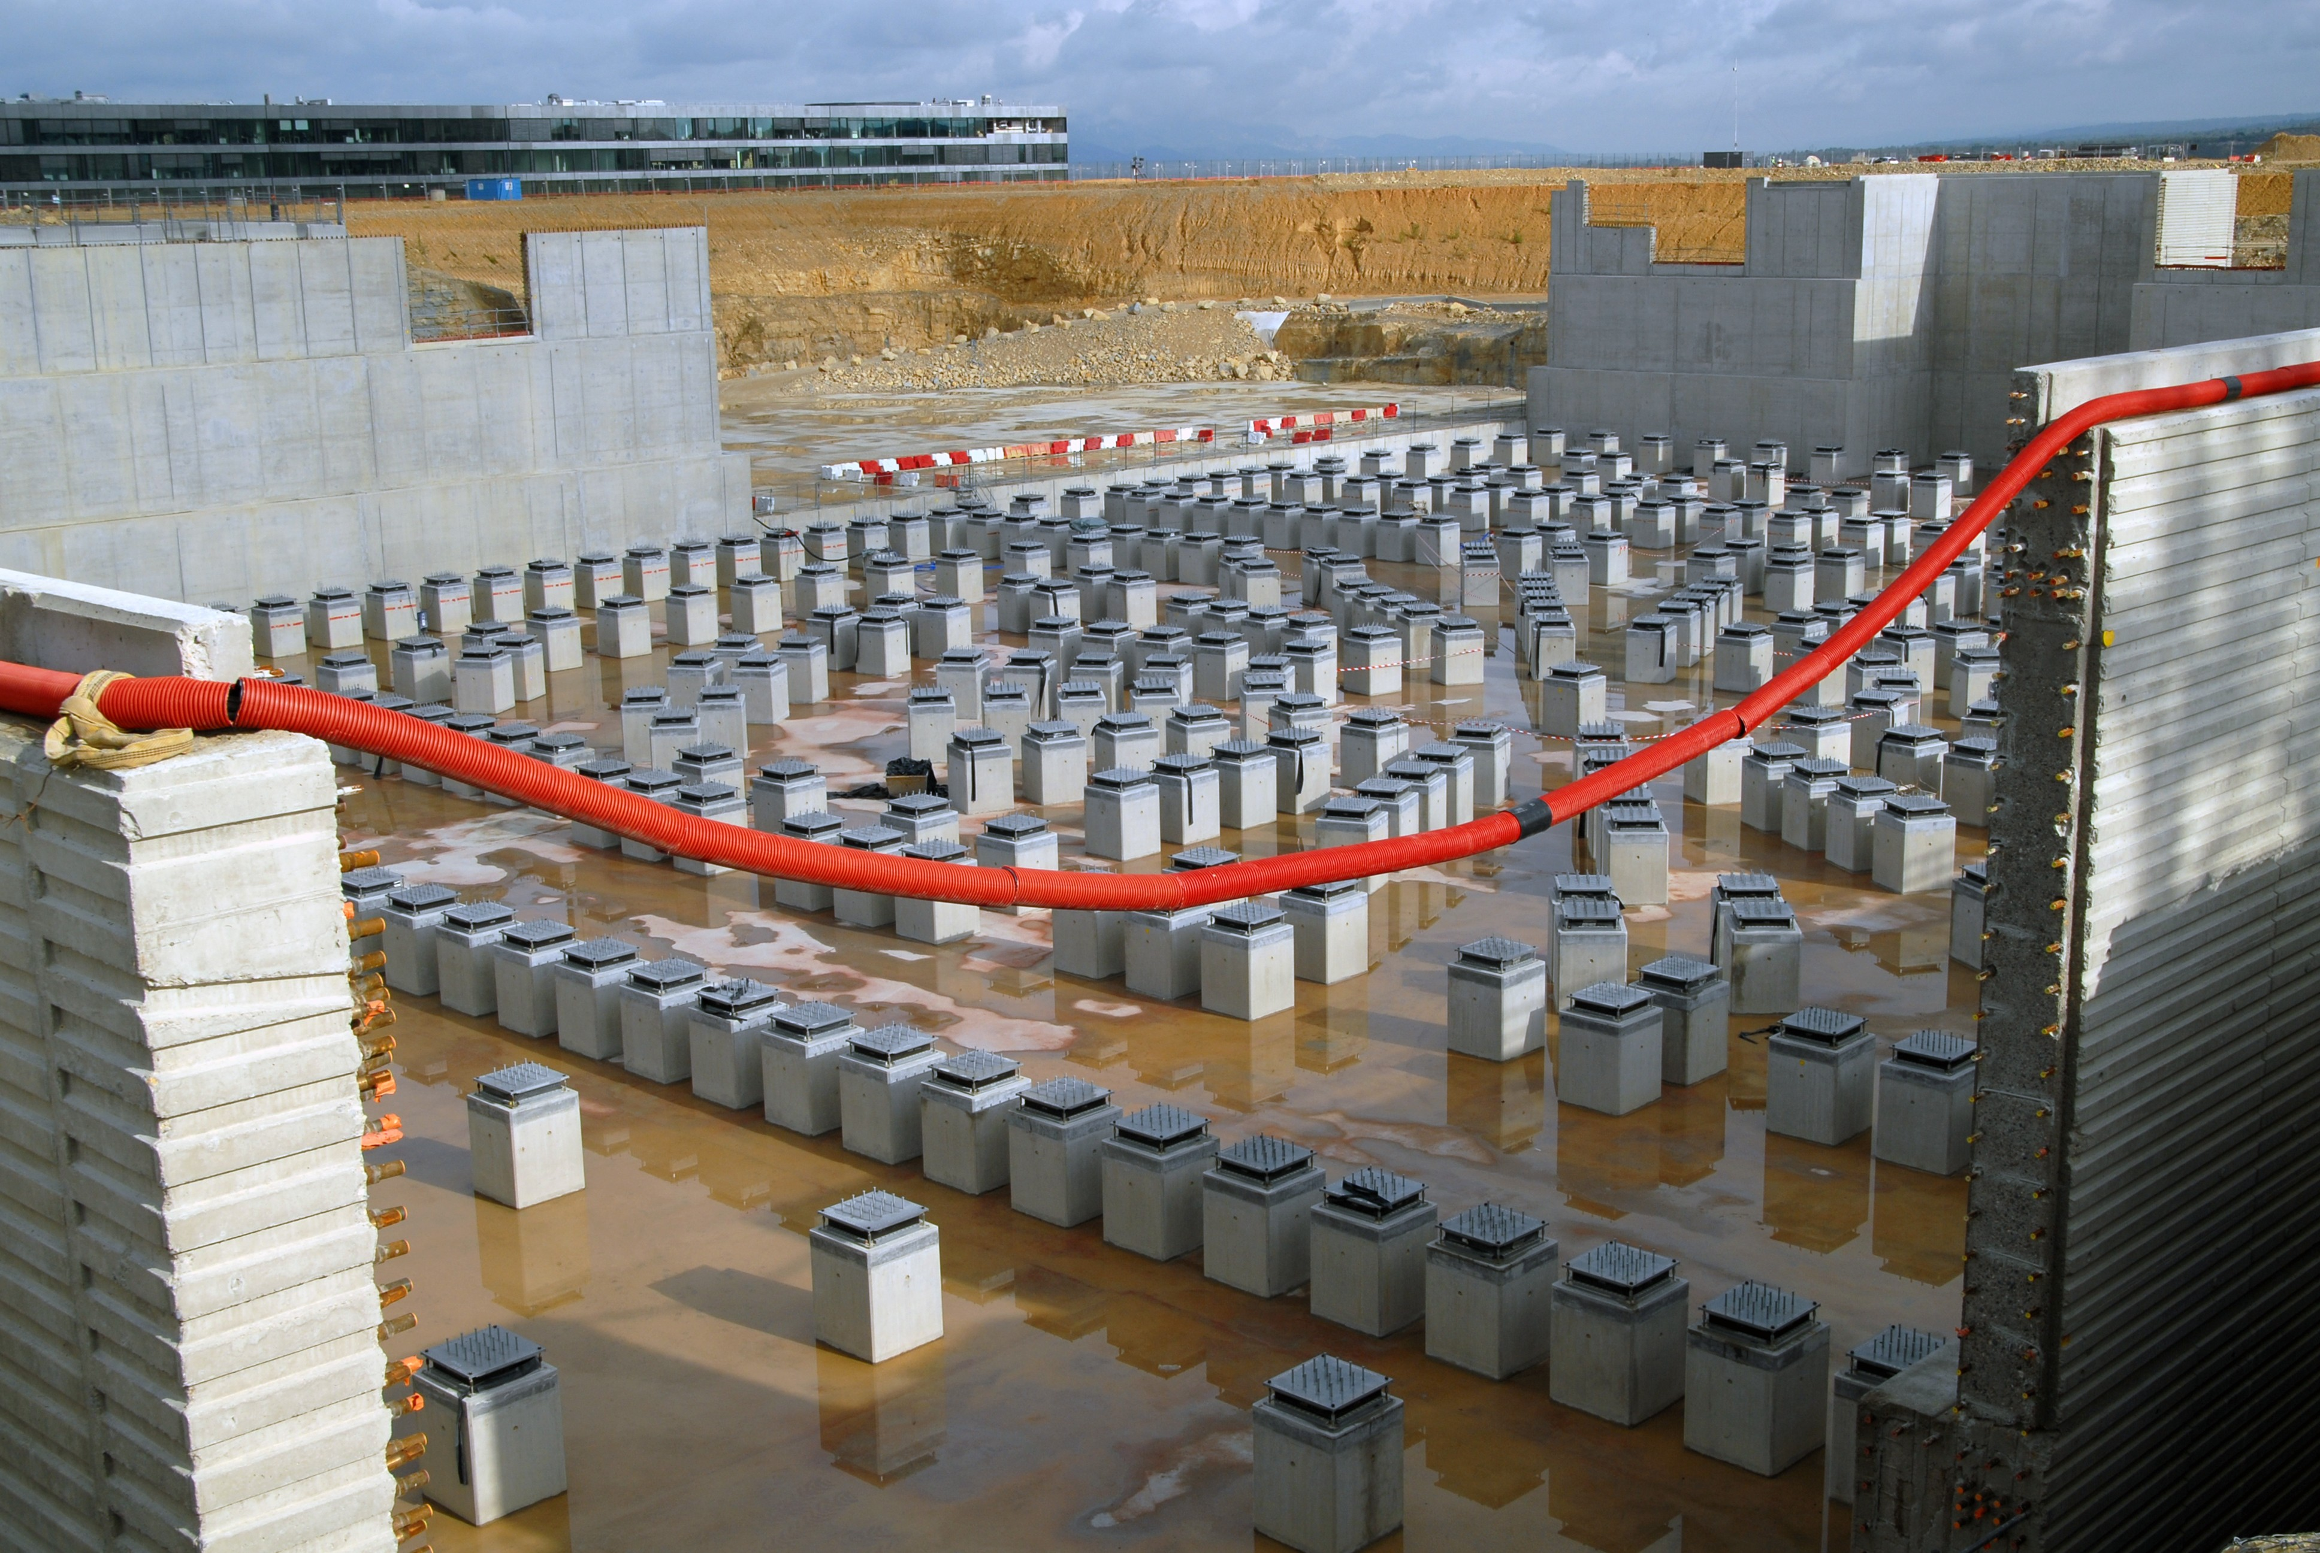

We have 493

Slide 7
493 x
+ 4 photos of the concrete part (NSEW)
+ 4 photos of the neoprene
+ 5 schemas with observed defects
+ additional comments
= inspection report 🥲

Slide 8
No in-house business application
No application on the market for this specific task
No extra budget
No extra time
…😐

Slide 9
Let’s start a Web Application!
There’s one small detail though…

Slide 10
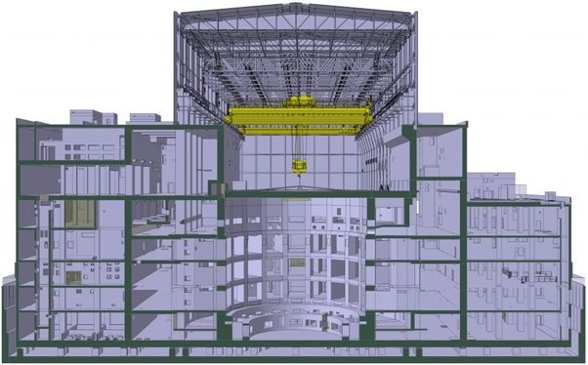
WE ARE HERE

Slide 11
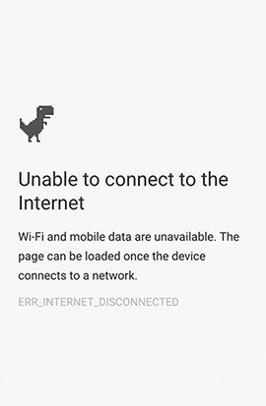
No cellular network
No WiFi
No web server on the devices

Slide 12
Web standards to the rescue

Slide 13

PROGRESSIVE WEB APP

Slide 14
What is a PWA?
Notes:
A PWA is a Web Application that can:
Be added to the device
Behaves like native apps
Work offline

Slide 15
We need:
HTTPS
Manifest
Service Worker

Slide 16
MANIFEST FILE
Simple JSON file with application details

Slide 17
MANIFEST FILE
Information and links to assets
Name / Short name
Look and feel
Configuration data
Icons or screenshots
…

Slide 18
MANIFEST FILE
{​ "name": "My Awesome Web App",​ "short_name": "awesome-app",​ "description": "Awesome application that will help you achieve your dreams.",​ "display": "standalone",​ "icons": [​ {​ "src": "/icons/icon-48x48.png",​ "type": "image/png",​ "sizes": "48x48"​ }​ ],​ "orientation": "any"​ }

Slide 19
MANIFEST FILE
<link rel="manifest" ​ href="/site.webmanifest" >

Slide 20
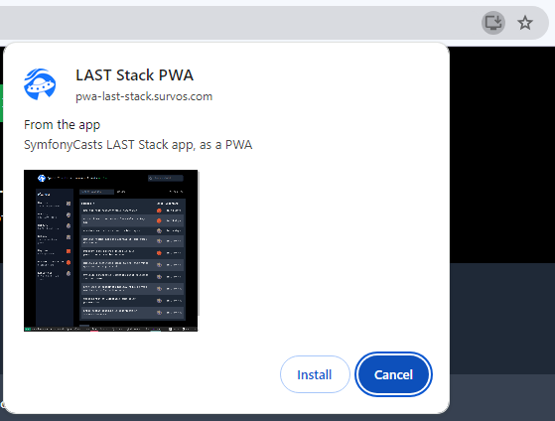
MANIFEST FILE
Other cool features such as Rich UI

Slide 21
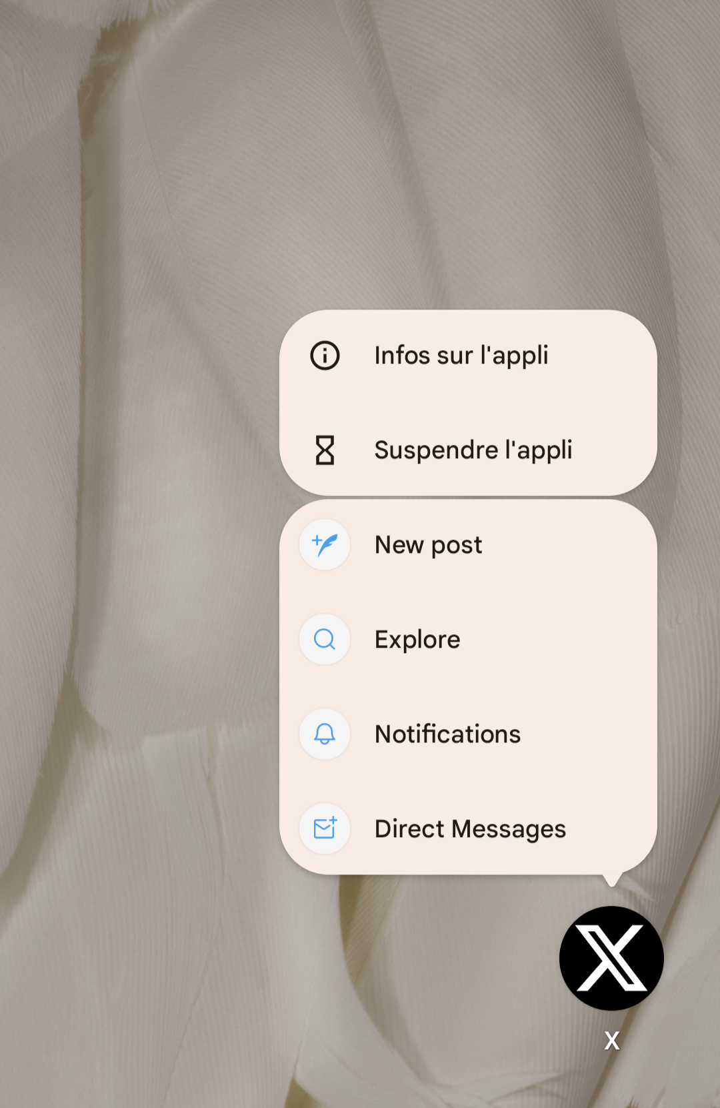
MANIFEST FILE
Other cool features such as Shortcuts

Slide 22
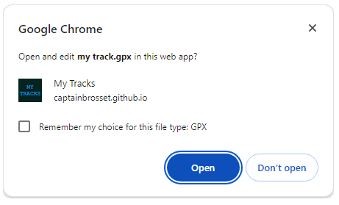
MANIFEST FILE
Other cool features such as File handling

Slide 23
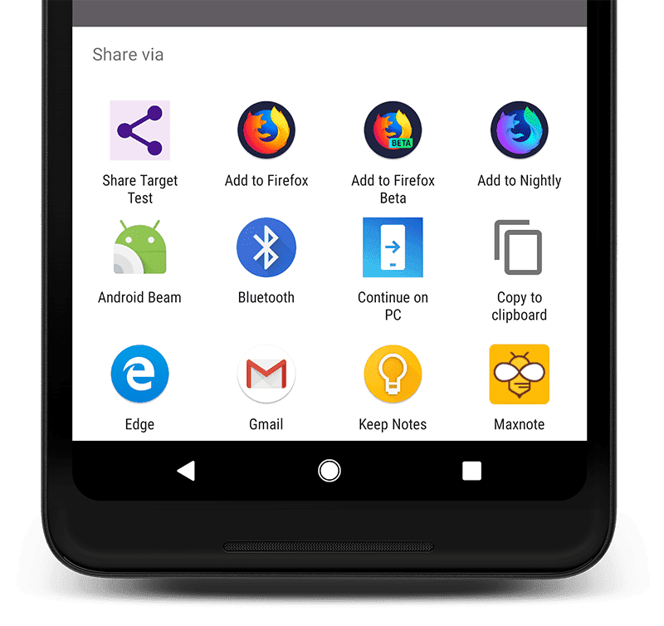
MANIFEST FILE
Other cool features such as Sharing system

Slide 24
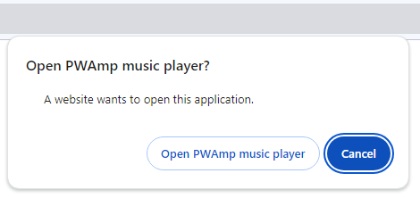
MANIFEST FILE
Other cool features such as Protocol handlers
Associate protocols such as mailto://, tel:// or custom (prefix web+)
web+amp://
Notes:
A link to web+audio://foo+bar will launch your application to a specific path with the foo+bar argument.

Slide 25
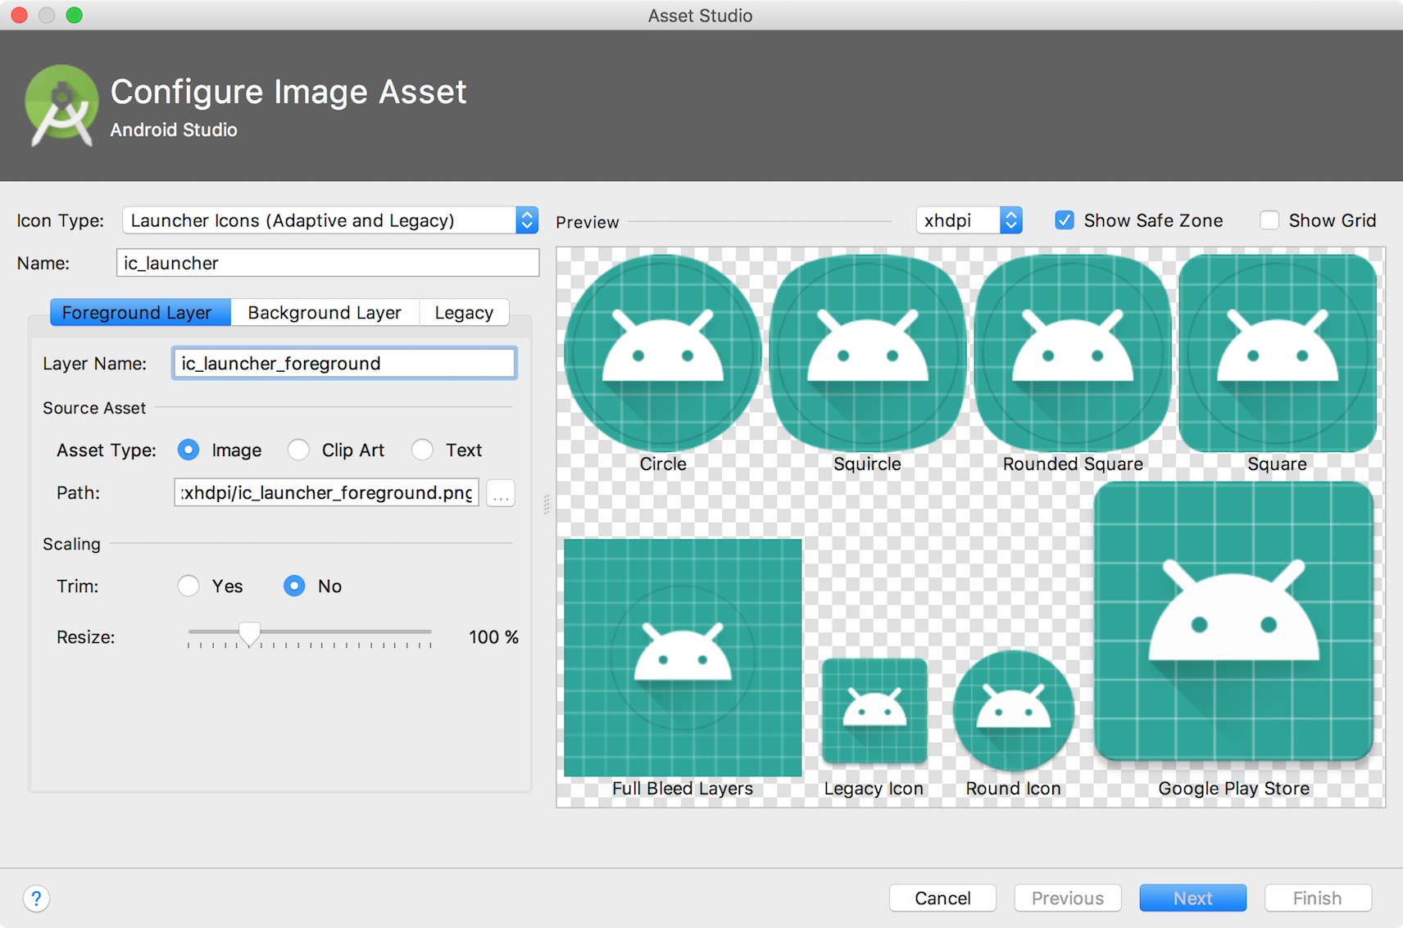
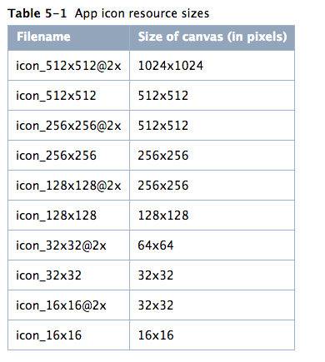
MANIFEST FILE
Easy to write
…except for images
Notes:
that can have multiple sizes to fit all platforms and devices (including maskable icons)

Slide 26
SERVICE WORKER
A standalone JS file that can do great things:
Acts as a network proxy to manage caching strategies
Communicate with other open tabs
Web Push notifications
Offline support

Slide 27
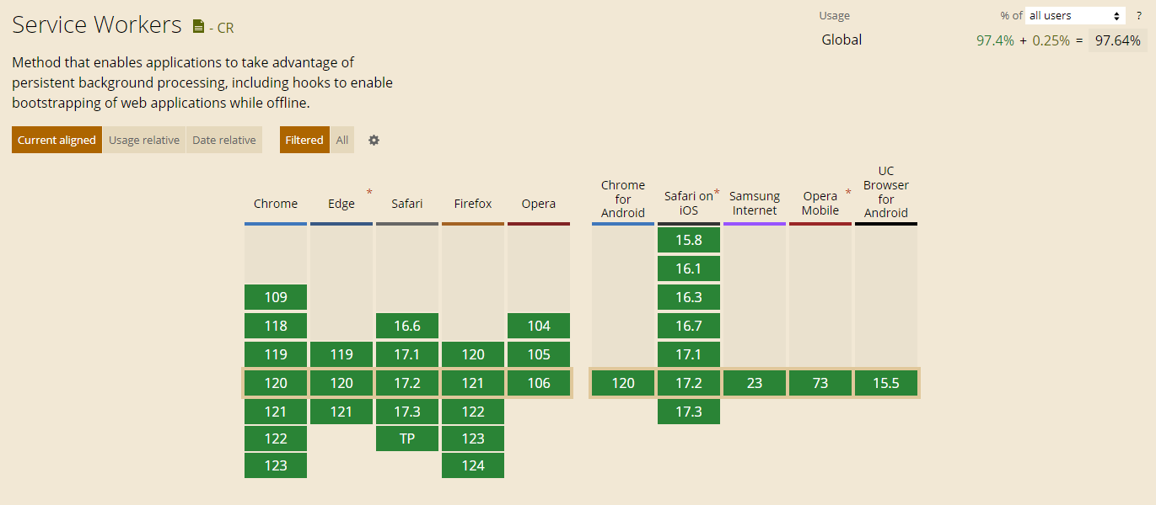
SERVICE WORKER

Slide 28
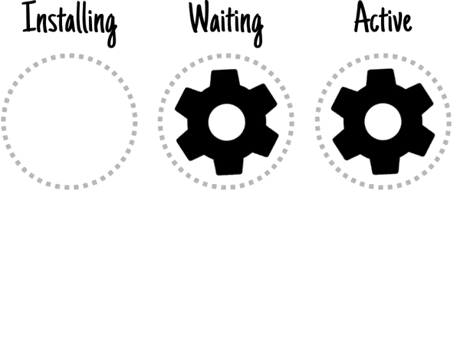
SERVICE WORKER
Be careful with the following specificities:
Run in a specific context: no DOM, stateless
Lifecycle
Async

Slide 29
SERVICE WORKER
const PRECACHE = 'precache-v1';
const RUNTIME = 'runtime';
const PRECACHE_URLS = [
'index.html',
'./', // Alias for index.html
'styles.css',
'../../styles/main.css',
'demo.js'
];
self.addEventListener('install', event => {
event.waitUntil(
caches.open(PRECACHE)
.then(cache => cache.addAll(PRECACHE_URLS))
.then(self.skipWaiting())
);
});
self.addEventListener('activate', event => {
const currentCaches = [PRECACHE, RUNTIME];
event.waitUntil(
caches.keys().then(cacheNames => {
return cacheNames.filter(cacheName => !currentCaches.includes(cacheName));
}).then(cachesToDelete => {
return Promise.all(cachesToDelete.map(cacheToDelete => {
return caches.delete(cacheToDelete);
}));
}).then(() => self.clients.claim())
);
});
self.addEventListener('fetch', event => {
if (event.request.url.startsWith(self.location.origin)) {
event.respondWith(
caches.match(event.request).then(cachedResponse => {
if (cachedResponse) {
return cachedResponse;
}
return caches.open(RUNTIME).then(cache => {
return fetch(event.request).then(response => {
return cache.put(event.request, response.clone()).then(() => {
return response;
});
});
});
})
);
}
});
JS…

Slide 30
SERVICE WORKER
Several ready-to-use solutions to simplify the way we develop a SW:
upup
Workbox

Slide 31
SERVICE WORKER
Example with Workbox
import { imageCache, staticResourceCache } from 'workbox-recipes'; import { NetworkOnly} from 'workbox-strategies';​​ import { registerRoute } from 'workbox-routing';​​

Slide 32
SERVICE WORKER
Example with Workbox
registerRoute(​​ /\/dashboard\/.*/,​​ new NetworkOnly(),​​ 'GET'​​ ); staticResourceCache(); imageCache();

Slide 33
SERVICE WORKER
Caching strategies
Network first
Network only
Cache first
Cache only
Stale-while-revalidate

Slide 34
SERVICE WORKER
Caching strategies depend on your application
Network first => pages that changes often (homepage)
Network only => a dashboard / private area
Cache first => article pages
Cache only => all versioned resources/assets
Stale-while-revalidate

Slide 35
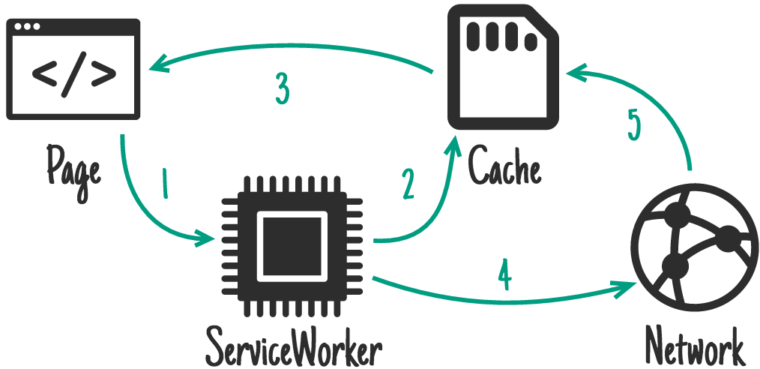
SERVICE WORKER
Caching strategies
Network first
Network only
Cache first
Cache only
Stale-while-revalidate

Slide 36
SERVICE WORKER
Lot of simple recipes out of the box
Broadcast update
Page/Image/Font/… cache
Expiration rules
Offline fallback

Slide 37
SERVICE WORKER
Nice for fetching data from the cache.
What about sending data offline?

Slide 38
SERVICE WORKER
BackgroundSync API ✨

Slide 39
SERVICE WORKER
A very simple API
Stores failed requests in queue
Delivers when the connectivity has returned.

Slide 40
SERVICE WORKER
const bgSyncPlugin = new BackgroundSyncPlugin(
'inspections',
{​ maxRetentionTime: 60*24*5 } // 5 days in minutes
);​
registerRoute(​ /\/inspections.*/,​ new NetworkOnly({​ plugins: [bgSyncPlugin] }),​ 'POST'​ );

Slide 41
SERVICE WORKER
Works even if the user has left the application.
=> You can send POST/PUT/PATCH/DELETE offline!

Slide 42
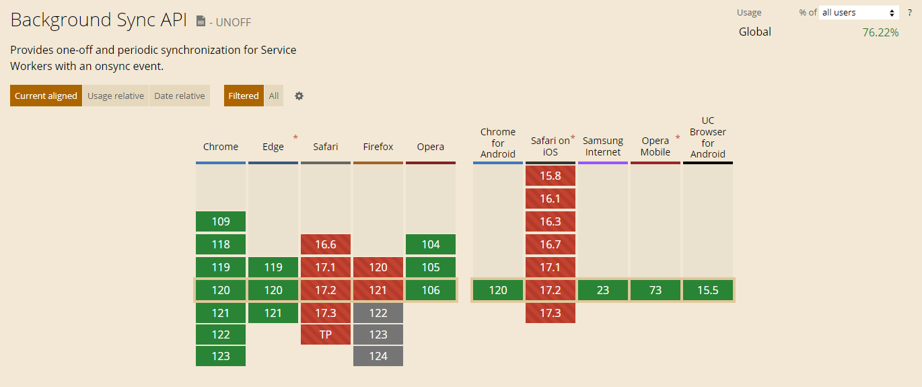
SERVICE WORKER

Slide 43

SERVICE WORKER
Topics you should take care
Credential's lifetime
CSRF protected forms (cannot be generated/checked)
Notes:
Scinder ici

Slide 44
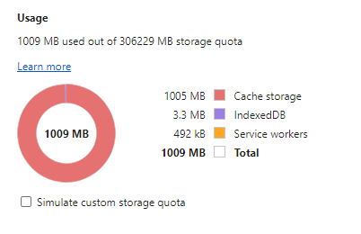
SERVICE WORKER
Topics you should take care
Personal or private data in cache
Large number of assets (Leaflet, Google Maps...)
Platform/Browser limitation
Notes:
Scinder ici

Slide 45
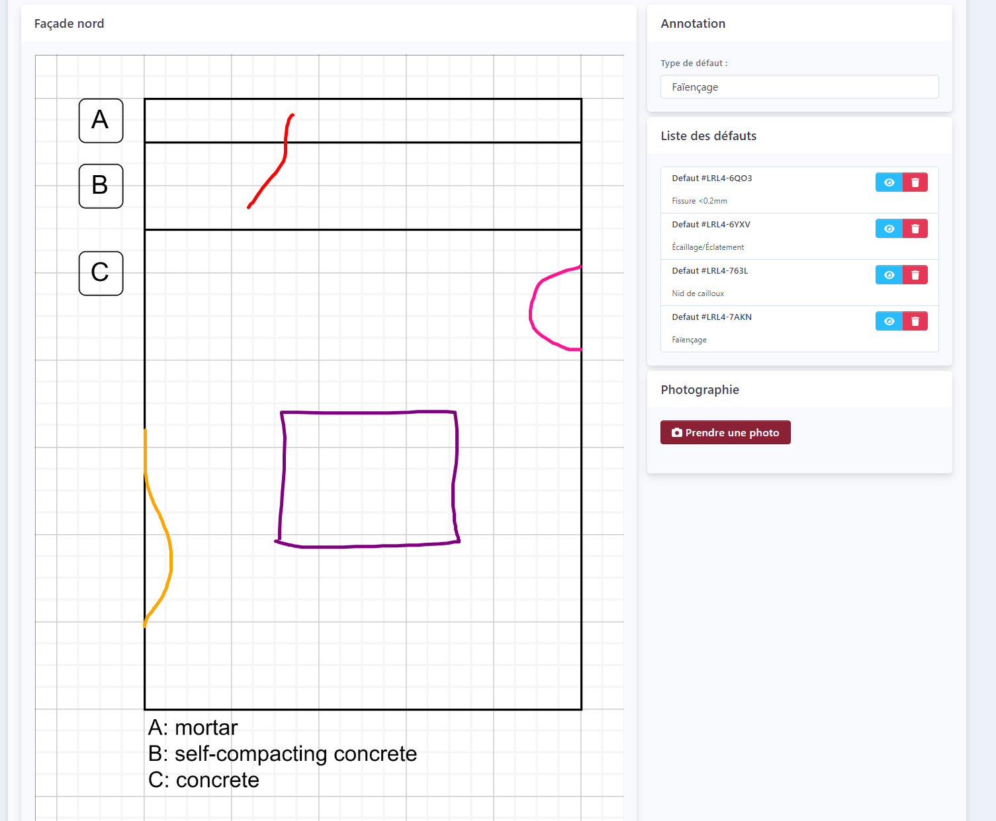
ASB INSPECTION?
Schemas annotated thanks to a Stimulus Controller (Symfony UX!)
One button per façade for taking pictures

Slide 46
ASB INSPECTION?
The page contains a <form>
Defect annotations are hidden fields populated with Stimulus Controller
Taking pictures is just a simple <input type=“file”> with extra attributes accept=“image/*;capture=camera” capture=“environment”
BackgroundSync plugin worked very well!

Slide 47

ASB INSPECTION?
~25 days to develop the application
Job done in 6 days instead of 15
Inspection Report issued the day after the inspections.

Slide 48
DEPLOYMENT
?!??
SW & Manifest generation simplification?

Slide 49
MANIFEST FILE
One interesting bundle but
Issue #119: LOOKING FOR ANOTHER CONTRIBUTOR
😐…
Outdated
Too complex
Too much dependencies

Slide 50
Symfony + Webpack Encore?
webpack-manifest-plugin:
Documentation
Currently maintained
~1.7M downloads/week
Looks good so far!

Slide 51
Symfony + Webpack Encore?
workbox-webpack-plugin:
Documentation
Currently maintained
~3.8M downloads/week
Cool, but…

Slide 52
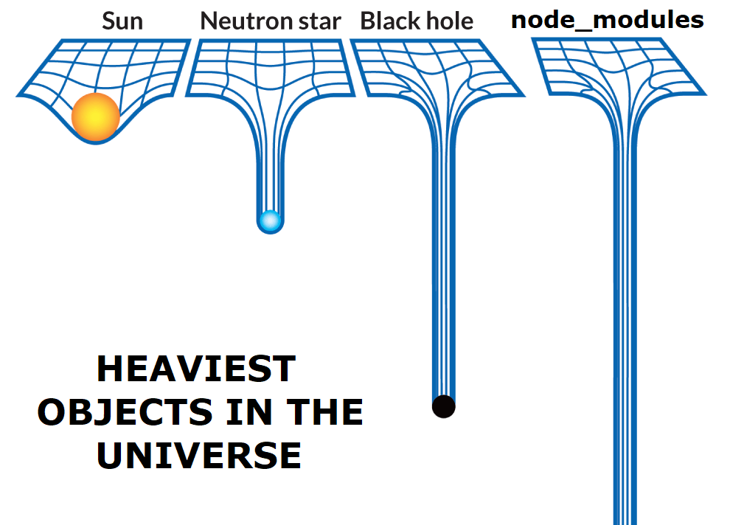
😬

Slide 53
MANIFEST FILE
Other questions I had in mind?
Asset Mapper?
Symfony Components?
Notes:
A modifier

Slide 54
INTRODUCING PWA BUNDLE
composer require spomky-labs/pwa-bundle

Slide 55
PWA BUNDLE
# config/packages/pwa.yaml
pwa:
manifest:
enabled: true
name: 'My App'
short_name: 'my-app'
description: 'My App description'
start_url: './'
display: 'standalone'
background_color: '#ffffff'
theme_color: '#ffffff'
orientation: 'portrait’
scope: '/'

Slide 56
PWA BUNDLE
Twig function
<head>
{{ pwa() }}
</head>

Slide 57
PWA BUNDLE
Deploy with Asset Mapper
symfony console asset-map:compile

Slide 58
PWA BUNDLE
pwa:
manifest:
shortcuts:
- name: "Action 1"
short_name: "action-1"
url: "/action1" # Relative path
description: "Action 1 description"
- name: "Action 2"
short_name: "action-2"
url:
path: "app_action2" # Route name
params: # Route parameters
foo: "bar"
param1: "value1"
description: "Action 2 description"

Slide 59
PWA BUNDLE
# config/packages/pwa.yaml
pwa:
manifest:
icons:
- src: "images/logo.png"
sizes: [48, 96, 128, 256, 512, 1024]
- src: "images/logo.svg"
purpose: 'maskable'
sizes: [0]
screenshots:
- src: "screenshots/android_dashboard.png"
platform: 'android'
label: "View of the dashboard on Android"

Slide 60
PWA BUNDLE
Create icons with ease.
symfony console pwa:create:icons images/logo.svg -f png

Slide 61
PWA BUNDLE
Create screenshots with ease.
(symfony/panther💕)
symfony console pwa:create:screenshot https://example.com

Slide 62
PWA BUNDLE
Create service worker with ease.
As simple as an empty file in assets/sw.js

Slide 63
PWA BUNDLE
# config/packages/pwa.yaml
pwa:
serviceworker: 'sw.js'

Slide 64
PWA BUNDLE
Automatically served by the twig function
<head>
{{ pwa() }}
</head>

Slide 65
PWA BUNDLE
If you use CSP rules e.g. with nelmio/security-bundle
<head>
{{ pwa(swAttributes= {nonce: csp_nonce('script')}) }}
</head>

Slide 66
PWA BUNDLE
Caching features enabled by default
Images,
(Google) Fonts,
Assets from Asset Mapper

Slide 67
PWA BUNDLE
Simple config options for:
URL warm cache
Offline fallback
BackgroundSync

Slide 68
PWA BUNDLE
# config/packages/pwa.yaml
pwa:
serviceworker:
workbox:
resource_caches:
- match_callback: 'navigate' # <= this is a keyword
preload_urls: # List of precached URLs/Routes/Paths
- 'app_homepage'
- path: 'app_feature'
params:
foo: 'bar'
offline_fallback:
page: 'app_offline_page'
image: 'images/fallback.png'
font: 'fonts/inter.ttf'

Slide 69
PWA BUNDLE
# config/packages/pwa.yaml
pwa:
serviceworker:
enabled: true
src: 'sw.js'
workbox:
background_sync:
- queue_name: 'api'
match_callback: 'startsWith: /api'
method: 'POST'

Slide 70
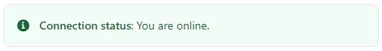
PWA BUNDLE
Stimulus Components:
@pwa/connection-status
@pwa/backgroundsync-form
@pwa/sync-broadcast
@pwa/prefetch-on-demand

Slide 71
PWA BUNDLE
Out of the box:
Not a single JS line to write 🤓
(still possible if you need/want to)

Slide 72
EXPERIMENTAL FEATURES
# config/packages/phpwa.yaml
pwa:
manifest:
enabled: true
name: 'app.name'
short_name: 'app.short_name'
description: 'app.description'
start_url: '/'
display: 'standalone'
background_color: '#ffffff'
theme_color: '#ffffff'
orientation: 'portrait’
scope: '/'

Slide 73
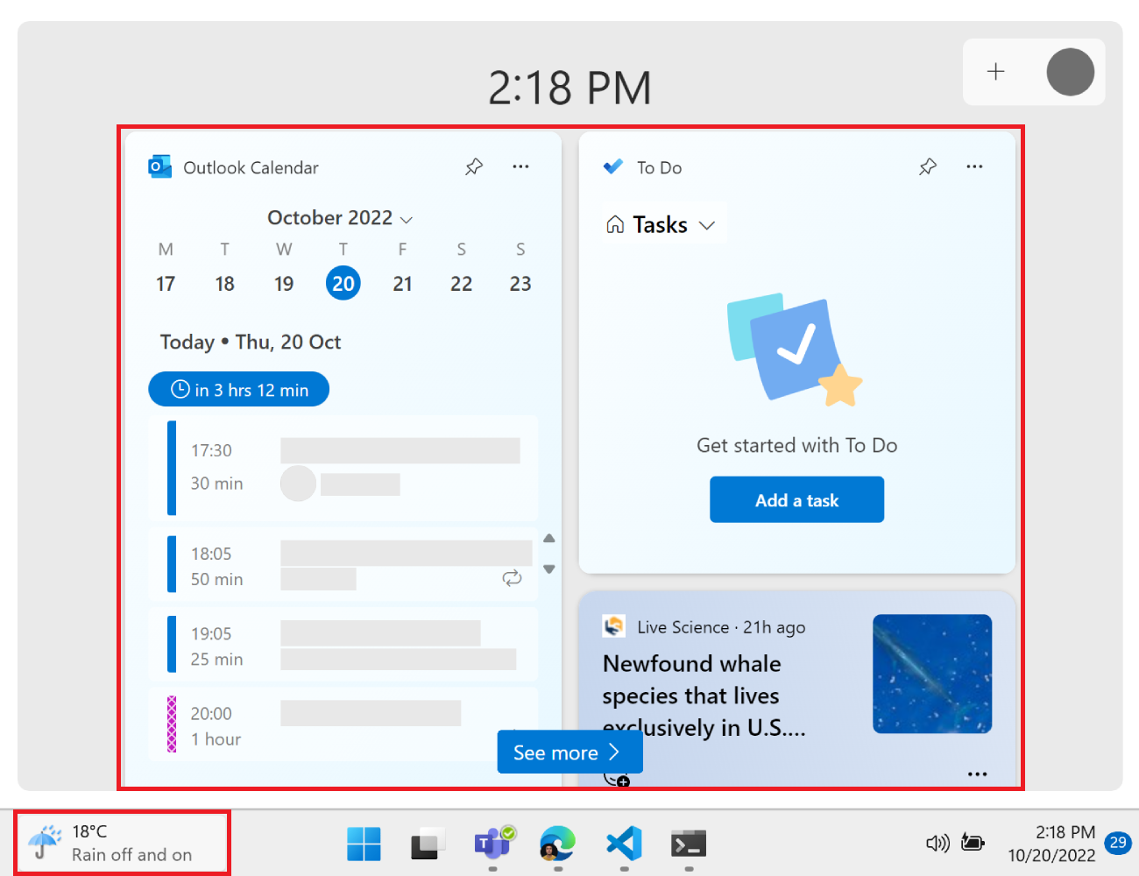
EXPERIMENTAL FEATURES
Widgets: work on Windows10+ only and developer mode enable.
Supported by the bundle and works like a charm 🪄

Slide 74
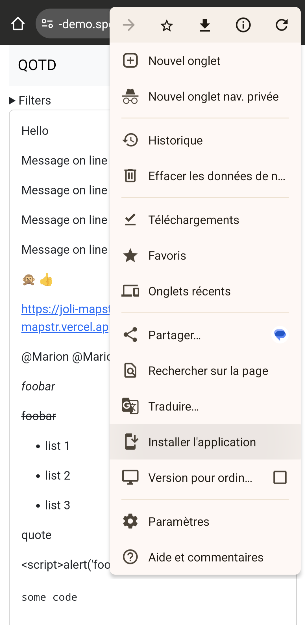

DEMO?
JoliApp for JoliQotd
https://pwa-demo.spomky-labs.com

Slide 75




APP STORES?

Slide 76
APP STORES?
Your app, Your choice:
PWAs are independent from any app store
Users are not required to install your PWA
It is possible to pack your app See https://www.pwabuilder.com/

Slide 77
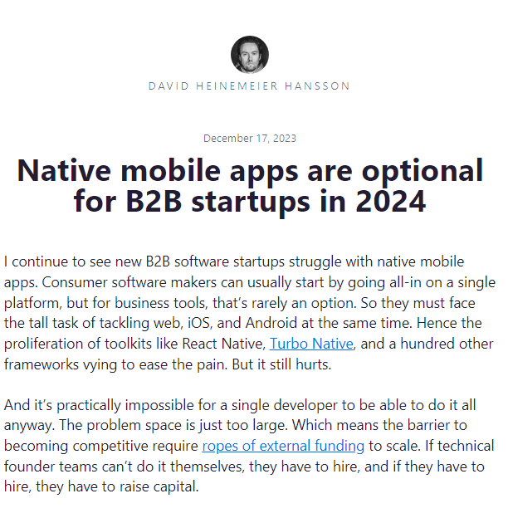
AND NOW?

Slide 78
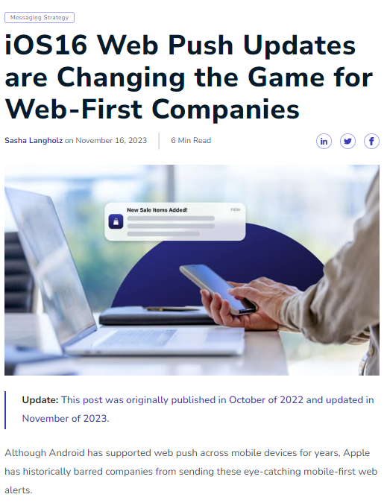
AND NOW?

Slide 79
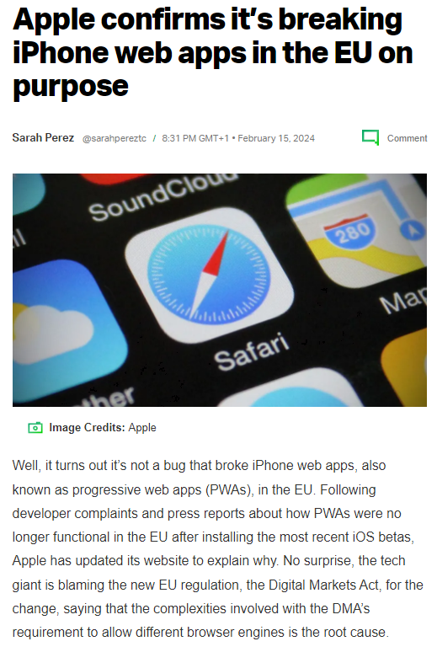
AND NOW?

Slide 80
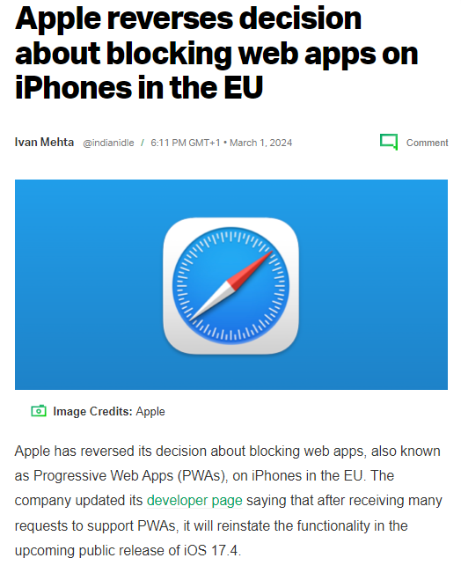
AND NOW?

Slide 81

AND NOW?
My company won a very big contract for inspections in Nuclear Power Plants

Slide 82
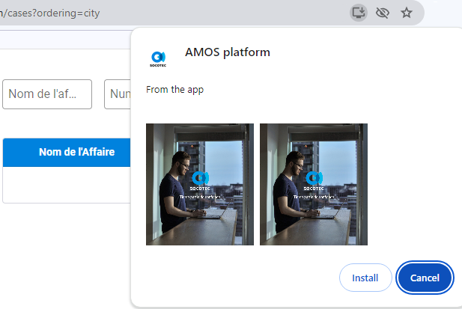
AND NOW?

Slide 83
CONCLUSION
Happy inspectors 🕵🏼
Happy manager👨🏼‍💼
Happy customer👌🏼
Happy developer ⌨️
Notes:
Déplacement professionnel

Slide 84




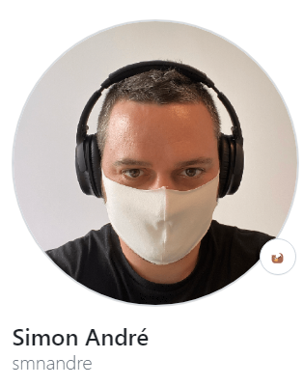

THANK YOU !

Slide 85
THANK YOU AND HAPPY CODING

